Slide 1

ERsed Respiration data- 2022
48 observations (sites) in total
Remove positive ERsed values (3 sites with ER_sed >0)
# Missing values: Hyporheic exchange flux (2), Chlorophyll_A(2),TSS(2),
Target variable in the MLR analysis: ERsed_square
Regression variables:
Depth, Velocity, Slope , Discharge
HOBO_Temp (water temperature)
Hyporheic exchange flux, Chlorophyll_A
totdasqkm (total drainage area),
D50_m, aridity, TSS, Stream order
PctMxFst2019Ws (%forest) , PctCrop2019Ws (%crop), PctShrb2019Ws(%Shrb)
GPP
Log transform for Slope, D50_m, totdasqkm, "Discharge", 'Average_Depth' and TSS

Slide 2
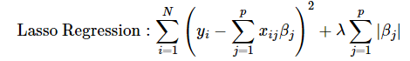
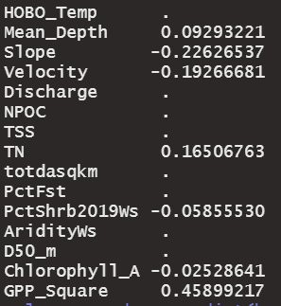
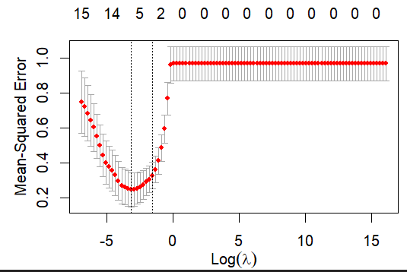
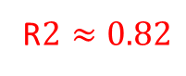
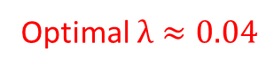
Lasso regression
Log transform variables(inputs and target variable) + normalized variables
Exclude PctAg(%Crop + %Pasture/Hay) due to skewed distribution after log transformation
Fill in TN with half of minimum value; fill in TSS with half LOD
Only 30 sites left after removing positive ERsed and NA in ChlA
R$2≈0.82$
Optimal $λ≈0.04$

Slide 3
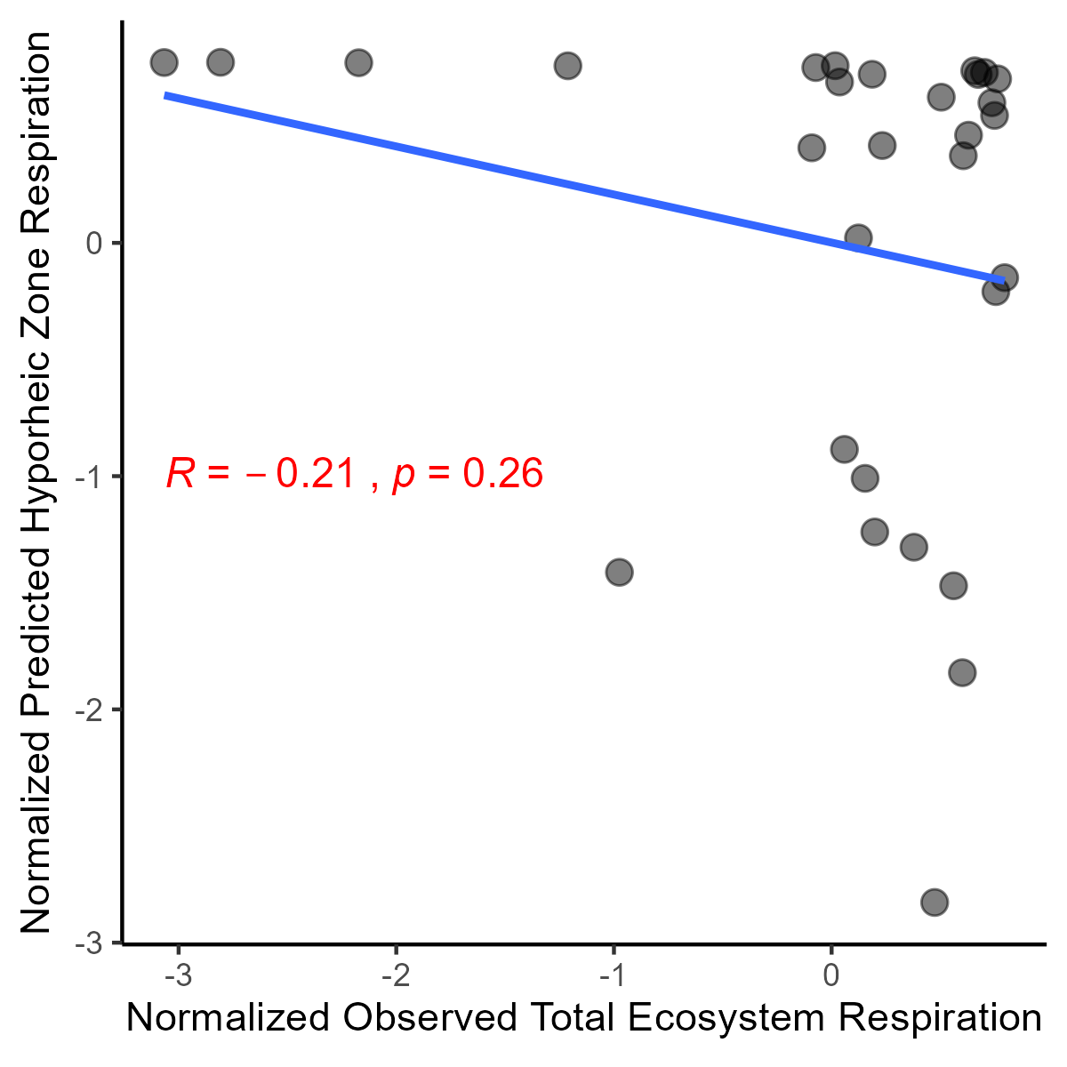
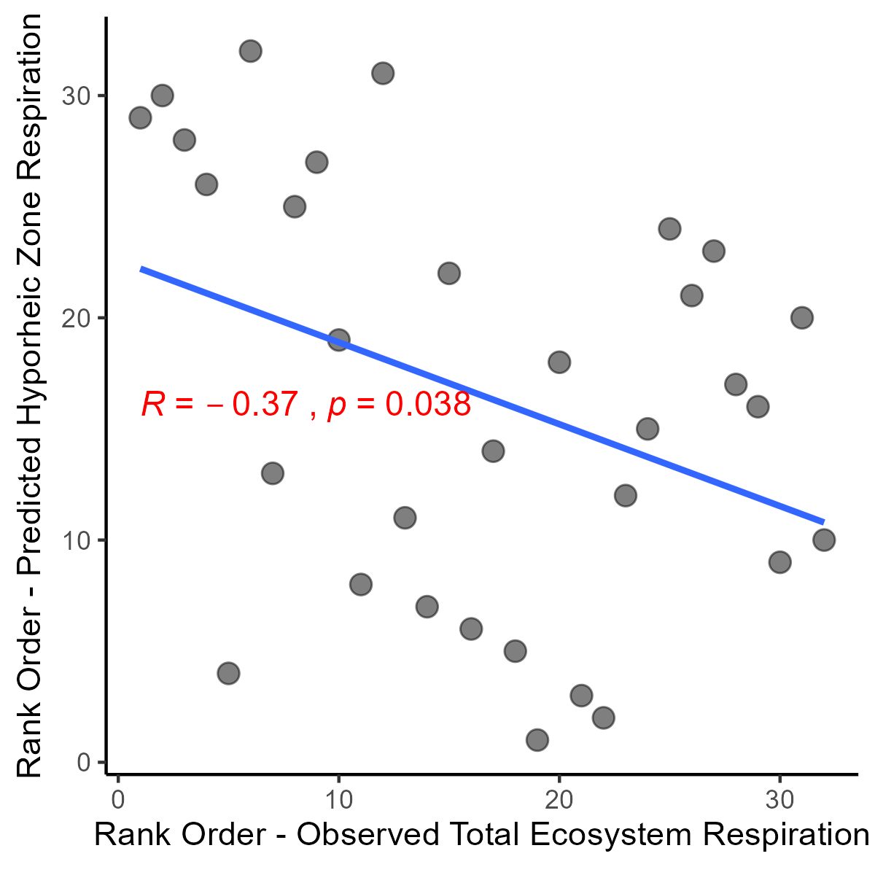
(a)
(b)

Slide 4
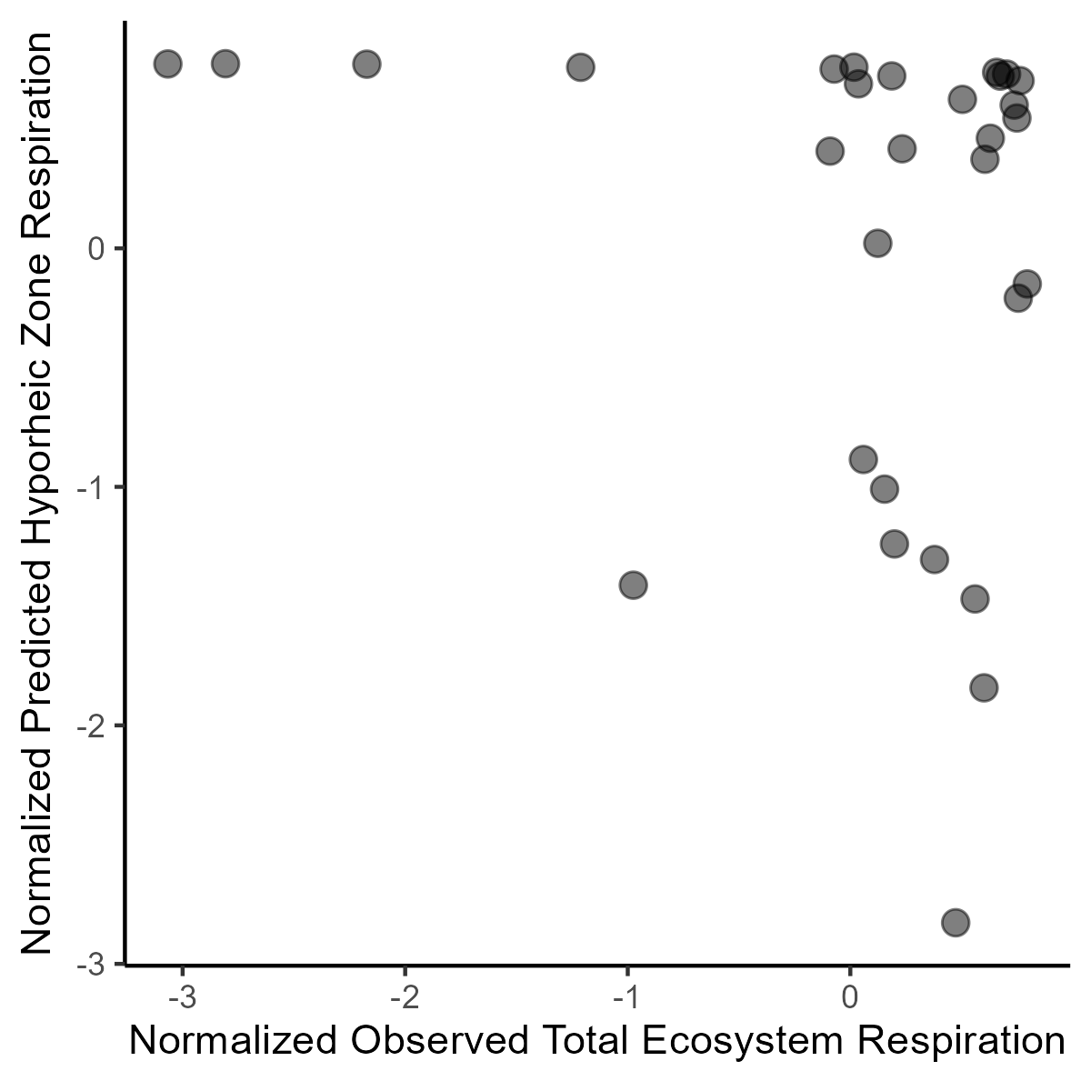
(a)
(b)

Slide 5
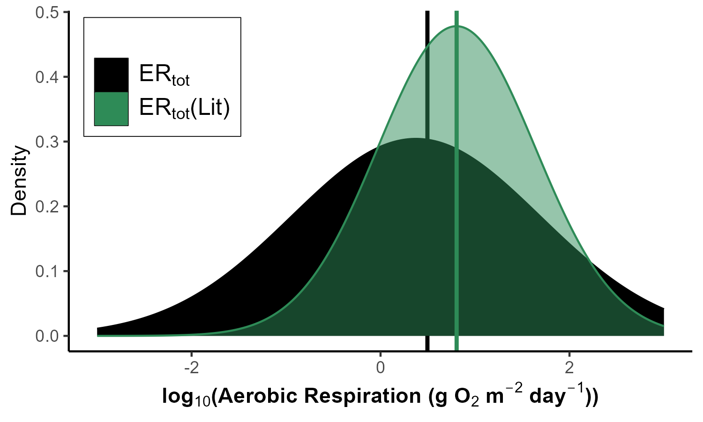
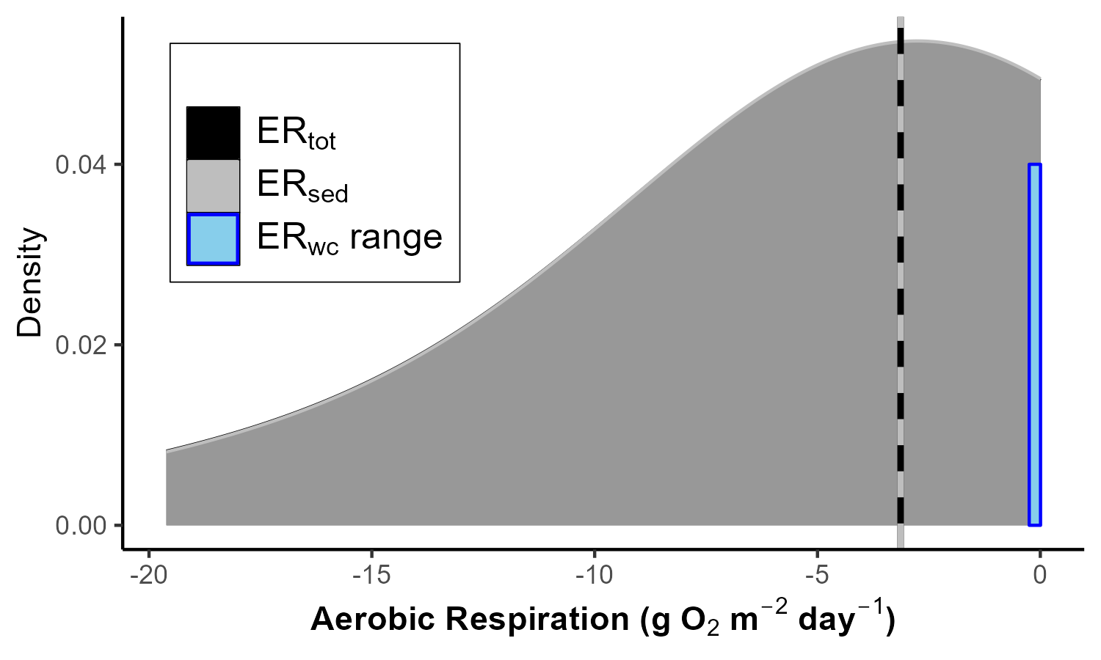
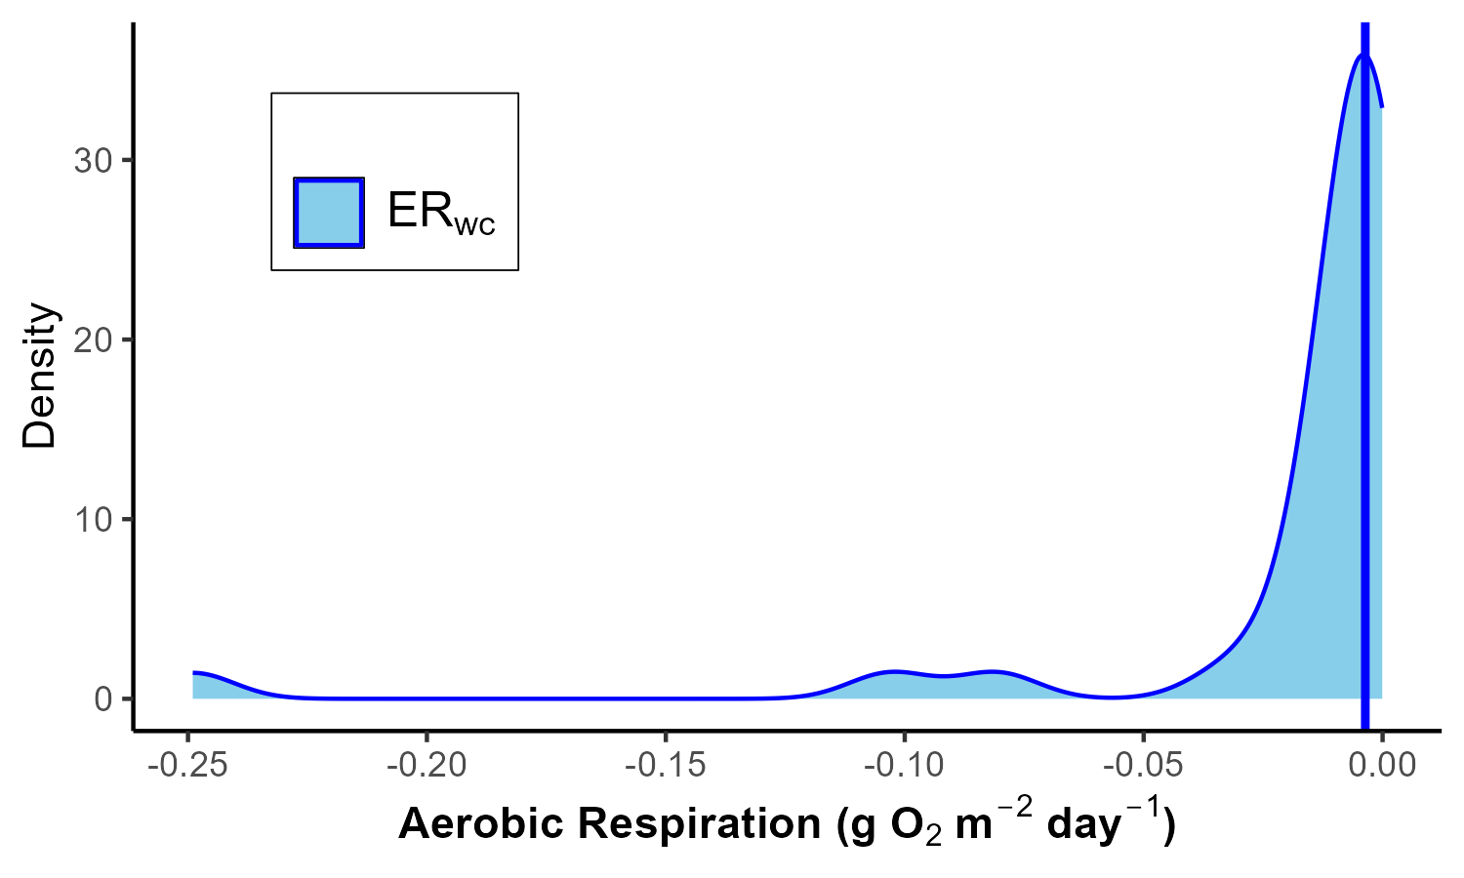
(a)
(b)
(c)

Slide 6


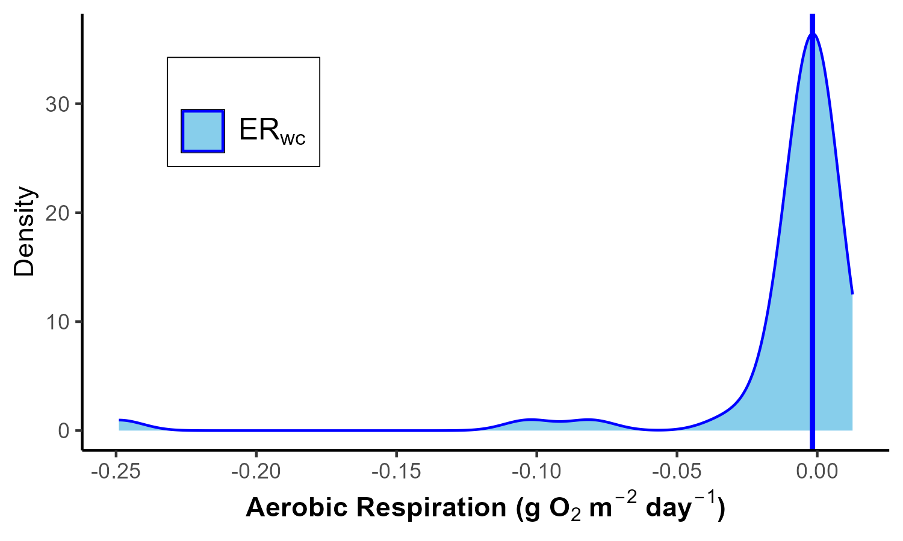
Erwc from 48 sites
(a)
(b)
(c)

